Slide 1
review
Lexical analyzer (scanner) 词法分析器
Syntax analyzer (parser) 语法分析器
Token 单词
Attribute 属性
Regular expression 正规/正则表达式
Regular definition 正规定义
Transition Diagram (TD) 转换图
Finite Automata (FA) 有限自动机
Nondeterministic Finite Automata (NFA) 不确定的有限自动机
Deterministic Finite Automata (DFA) 确定的有限自动机
◎2005 ECNU SEI
Compilers: Principles, Techniques, and Tools

Slide 2
Lexical Analysis (Scanning)
Basic Concepts & Regular Expressions
  What does a Lexical Analyzer do?
  How does it Work?
  Formalizing Token Definition & Recognition
LEX - A Lexical Analyzer Generator
◎2005 ECNU SEI
Compilers: Principles, Techniques, and Tools

Slide 3
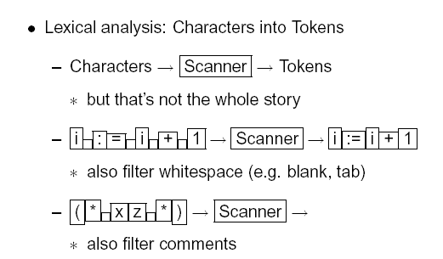
◎2005 ECNU SEI
Compilers: Principles, Techniques, and Tools

Slide 4
Lexical Analysis (cont.)
Reviewing Finite Automata Concepts
  Non-Deterministic and Deterministic FA
  Conversion Process
    Regular Expressions to NFA
    NFA to DFA
    Regular Expressions to DFA
Relating NFAs/DFAs /Conversion to Lexical Analysis
Concluding Remarks /Looking Ahead
◎2005 ECNU SEI
Compilers: Principles, Techniques, and Tools

Slide 5
Lexical Analysis (cont.)
Reading the source program as a file of characters.
Dividing the file up into tokens.
Tokens（单词）: represents a unit of information in the source program.
Examples: keywords（关键词/保留字）, identifiers（标识符）, arithmetic symbols, multicharacter symbols(>=, <>).
Emphasis:
specification and recognition of tokens—Regular expression
（正规/正则表达式）
how to recognize tokens--Finite automata（有限自动机）
design of a lexical analyzer—programming in C or LEX
◎2005 ECNU SEI
Compilers: Principles, Techniques, and Tools

Slide 6
3.1 The Role of the Lexical Analyzer
Lexical Analyzer (词法分析器) is the first phase of a compiler, it reads the source program character by character to produce tokens for syntax analysis.
Normally a lexical analyzer doesn’t return a list of tokens at one shot, it returns a token when the parser asks a token from it.
Lexical analyzer = scanning + lexical analysis
◎2005 ECNU SEI
Compilers: Principles, Techniques, and Tools
Notes:
lec01-lexicalanalyzer

Slide 7
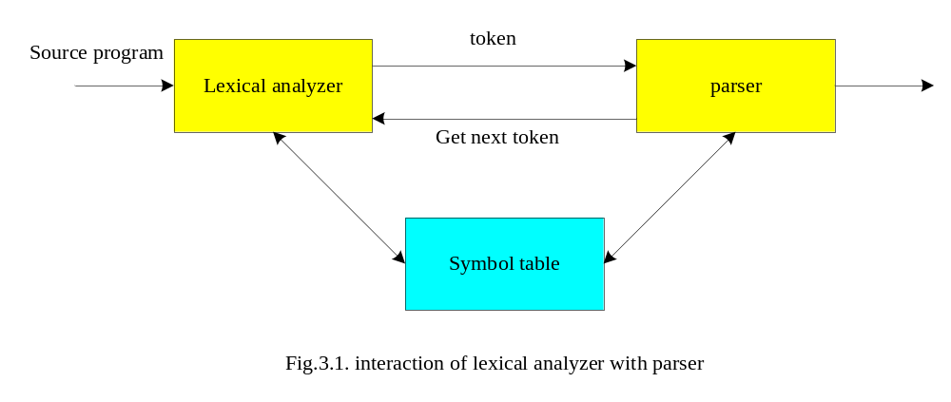
What are responsibilities of each box ?
◎2005 ECNU SEI
Compilers: Principles, Techniques, and Tools

Slide 8
Issues in lexical analysis
Separation of Lexical Analysis From Parsing Presents a Simpler Conceptual Model
  From a Software Engineering Perspective Division Emphasizes
    High Cohesion and Low Coupling
    Implies Well Specified ⇒ Parallel Implementation
Separation Increases Compiler Efficiency (I/O Techniques to Enhance Lexical Analysis)
Separation Promotes Portability.
  This is critical today, when platforms (OSs and Hardware) are numerous and varied!
  Emergence of Platform Independence – Java
◎2005 ECNU SEI
Compilers: Principles, Techniques, and Tools

Slide 9
Lexical Analyzer in Perspective
LEXICAL ANALYZER
  Scan Input
  Remove WS, NL, …
  Identify Tokens
  Create Symbol Table
  Insert Tokens into ST
  Generate Errors
  Send Tokens to Parser
PARSER
  Perform Syntax Analysis
  Actions Dictated by Token Order
  Update Symbol Table Entries
  Create Abstract Rep. of Source
  Generate Errors
  And More…. (We’ll see later)
◎2005 ECNU SEI
Compilers: Principles, Techniques, and Tools

Slide 10
Introducing Basic Terminology
What are Major Terms for Lexical Analysis?
  TOKEN
    A classification for a common set of strings
    Examples Include <Identifier>, <number>, etc.
  PATTERN
    The rules which characterize the set of strings for a token
    Recall File and OS Wildcards ([A-Z]*. *)
  LEXEME
    Actual sequence of characters that matches pattern and is classified by a token
    Identifiers: x, count, name, etc…
◎2005 ECNU SEI
Compilers: Principles, Techniques, and Tools

Slide 11
Token, pattern, lexemes
Since a token can represent more than one lexeme, additional information should be held for that specific lexeme. This additional information is called as the attribute (属性)of the token.
For simplicity, a token may have a single attribute which holds the required information for that token.
  For identifiers, this attribute a pointer to the symbol table, and the symbol table holds the actual attributes for that token.
Token type and its attribute uniquely identifies a lexeme.
Regular expressions （正规表达式）are widely used to specify patterns.
◎2005 ECNU SEI
Compilers: Principles, Techniques, and Tools

Slide 12
Token, pattern, lexemes
Token is a logical unit in the scanner.
A lexeme is a instance of token.
Token
Sample Lexemes
Informal Description of Pattern
const
if
relation
id
num
literal
const
if
<, <=, =, < >, >, >=
pi, count, D2
3.1416, 0, 6.02E23
“core dumped”
const
if
< or <= or = or < > or >= or >
letter followed by letters and digits
any numeric constant
any characters between “ and “ except “
Actual values are critical. Info is :
1. Stored in symbol table
2. Returned to parser
Classifies Pattern
Fig.3.2 Examples of tokens.
◎2005 ECNU SEI
Compilers: Principles, Techniques, and Tools
Notes:
lec01-lexicalanalyzer

Slide 13
Attributes for tokens
An attribute of the token : any value associated to a token
The lexical analyzer collects information about tokens into their associated attributes.
The tokens influence parsing decisions; the attributes influence the translation of tokens.
Usually a token has only a single attribute—a pointer to the symbol table entry in which the information about the token is kept.
Some attributes: (cf. example 3.1)
  <id,attr> where attr is pointer to the symbol table
  <assgop,_> no attribute is needed (if there is only one assignment operator)
  <num,val> where val is the actual value of the number.
◎2005 ECNU SEI
Compilers: Principles, Techniques, and Tools

Slide 14
Scanning process
tokens : the logical units which the scanner generates.
Tokens fall into several categories:
  Reserved words: IF, THEN
  Identifiers: ID
  operation symbols: PLUS, MINUS
  Numbers: NUM
  Character and string: STR
  Others: {, }, (, ), ;, ”, ’, /, *
◎2005 ECNU SEI
Compilers: Principles, Techniques, and Tools

Slide 15
Scanning process (cont.)
Lexeme (string value): the strings of characters represented by a token.
Tokens one lexeme or many lexemes
An attribute of the token : any value associated to a token
Tokens many attributes
The scanner needs to compute at least as many attributes of a token .
◎2005 ECNU SEI
Compilers: Principles, Techniques, and Tools

Slide 16
A token record :
Typedef struct
{ TokenType tokenval;
char *stringval;
int numval;
} TokenRecord
A more common arrangement: the scanner return the token value only and place the other attributes in variables (such as in LEX and YACC).
The string of input characters is kept in a buffer or provided by the system input facilities.
◎2005 ECNU SEI
Compilers: Principles, Techniques, and Tools

Slide 17
3.2 Input buffering
Character-at-a-time I/O (getc, ungetc)
Block / Buffered I/O
  Utilize Block of memory
  Stage data from source to buffer block at a time
  Maintain two blocks - Why (Recall OS)?
    Asynchronous I/O - for 1 block
    While Lexical Analysis on 2nd block
Block 1
Block 2
When done, issue I/O
ptr...
Still Process token in 2nd block
◎2005 ECNU SEI
Compilers: Principles, Techniques, and Tools

Slide 18
Algorithm: Buffered I/O with Sentinels
Current token
E
=
M
*
eof
C
*
*
2
eof
eof
lexeme beginning
forward (scans ahead to find pattern match)
forward : = forward + 1 ;
if forward ↑ = eof then begin
if forward at end of first half then begin
reload second half ;
forward : = forward + 1
end
else if forward at end of second half then begin
reload first half ;
move forward to beginning of first half
end
else / * eof within buffer signifying end of input * /
terminate lexical analysis
end
Algorithm performs
I/O’s. We can still
have get & ungetchar
Now these work on
real memory buffers !
Block I/O
Block I/O
Fig.3.6 Lookahead code with sentinels.
2nd eof ⇒ no more input !
◎2005 ECNU SEI
Compilers: Principles, Techniques, and Tools
Notes:
lec01-lexicalanalyzer

Slide 19
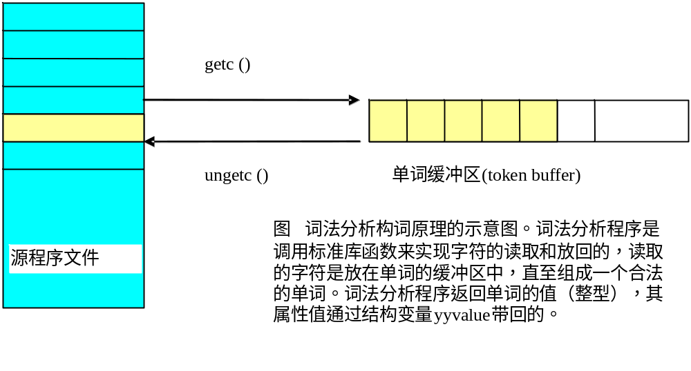
Character-at-a-time I/O
◎2005 ECNU SEI
Compilers: Principles, Techniques, and Tools

Slide 20
3.3 Specification of tokens
Language Concepts :
A language, L, is simply any set of strings over a fixed alphabet.
Alphabet
Languages
{0,1} {0,10,100,1000,100000…}
{0,1,00,11,000,111,…}
{a,b,c} {abc,aabbcc,aaabbbccc,…}
{A, … ,Z} {TEE,FORE,BALL,…}
{FOR,WHILE,GOTO,…}
{A,…,Z,a,…,z,0,…9, { All legal PASCAL progs}
+,-,…,<,>,…} { All grammatically correct English sentences }
Special Languages: ∅ - EMPTY LANGUAGE
{∈} - contains ∈ string only
◎2005 ECNU SEI
Compilers: Principles, Techniques, and Tools
Notes:
lec01-lexicalanalyzer

Slide 21
Terminology of Languages
Alphabet : a finite set of symbols (ASCII characters)
String :
  Finite sequence of symbols on an alphabet
  Sentence and word are also used in terms of string
  ε is the empty string
  |s| is the length of string s.
◎2005 ECNU SEI
Compilers: Principles, Techniques, and Tools

Slide 22
Terminology of Languages(cont. cf. Fig.3.7)
EXAMPLES AND OTHER CONCEPTS:
Suppose: S is the string banana
Prefix : ban, banana
Suffix : ana, banana
Substring : nan, ban, ana, banana
Subsequence: bnan, nn
Proper prefix, subfix, or substring cannot be all of S
◎2005 ECNU SEI
Compilers: Principles, Techniques, and Tools
Notes:
lec01-lexicalanalyzer

Slide 23
Terminology of Languages (cont.)
Language: sets of strings over some fixed alphabet
  ∅ the empty set is a language.
  {ε} the set containing empty string is a language
  The set of all possible identifiers is a language.
Operators on Strings:
  Concatenation: xy represents the concatenation of strings x and y. s ε = s ε s = s
  s^{n} ₌ s s s .. s ( n times) s⁰ ₌ ε
◎2005 ECNU SEI
Compilers: Principles, Techniques, and Tools

Slide 24
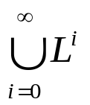

Operations on Languages
OPERATION
DEFINITION
union of L and M written L ∪ M
L ∪ M = {s | s is in L or s is in M}
concatenation of L and M written LM
LM = {st | s is in L and t is in M}
Kleene closure of L written L*
L*=
L* denotes “zero or more concatenations of “ L
positive closure of L written L⁺
L⁺=
L⁺ denotes “one or more concatenations of “ L
Fig.3.8 Definitions of operations on languages.
◎2005 ECNU SEI
Compilers: Principles, Techniques, and Tools
Notes:
lec01-lexicalanalyzer

Slide 25
Operations on Languages (Examples3.2)
L = {A, B, C, D } D = {1, 2, 3}
L ∪ D = {A, B, C, D, 1, 2, 3 }
LD = {A1, A2, A3, B1, B2, B3, C1, C2, C3, D1, D2, D3 }
L² = { AA, AB, AC, AD, BA, BB, BC, BD, CA, … DD}
L⁴ = L² L² = ??
L* = { All possible strings of L plus ∈ }
L⁺ = L* - ∈
L (L ∪ D ) = ??
L (L ∪ D )* = ??
{is the set of all four-letter strings}
{is the set of strings beginning with a letter followed by a letter or digit}
{is the set of all strings of letters and digits beginning with a letter}
◎2005 ECNU SEI
Compilers: Principles, Techniques, and Tools
Notes:
lec01-lexicalanalyzer

Slide 26
Language & Regular Expressions
A Regular Expression is a Set of Rules / Techniques for Constructing Sequences of Symbols (Strings) From an Alphabet.
Let Σ be an Alphabet, r a Regular Expression. Then L(r) is the Language, that is Characterized by the Rules of r.
◎2005 ECNU SEI
Compilers: Principles, Techniques, and Tools
Notes:
lec01-lexicalanalyzer

Slide 27
Regular Expressions
We use regular expressions to describe tokens of a programming language.
A regular expression is built up of simpler regular expressions using a set of defining rules.
Each regular expression r denotes a language L(r).
A language L(r) denoted by a regular expression r is called as a regular set.
◎2005 ECNU SEI
Compilers: Principles, Techniques, and Tools

Slide 28
Regular Expressions (cont.)
a regular expression r: is defined by the set of strings that it matches.
L(r): language generated by the regular expression.
Character set: be set of the ASCII characters or some subset of it
∑: legal symbols, called alphabet.
A regular repression symbols indicates patterns, metacharacters (metasymbols).
Backslash and quotes(escape character): turns off the special meaning of a metacharacter.
◎2005 ECNU SEI
Compilers: Principles, Techniques, and Tools
Notes:
lec01-lexicalanalyzer
Metacharacter: 元字符；metasymbol: 元符号

Slide 29
Rules for Specifying Regular Expressions
fix alphabet Σ
∈ is a regular expression denoting {∈}
If a is in Σ, a is a regular expression that denotes {a}
Let r and s be regular expressions with languages L(r) and L(s). Then
    (r) | (s) is a regular expression ⇒ L(r) ∪ L(s)
    (r)(s) is a regular expression ⇒ L(r) L(s)
    (r)* is a regular expression ⇒ (L(r))*
    (r) is a regular expression ⇒ L(r)
All are Left-Associative. Parentheses are dropped as allowed by precedence rules.
precedence
◎2005 ECNU SEI
Compilers: Principles, Techniques, and Tools
Notes:
lec01-lexicalanalyzer

Slide 30
Rules for Specifying Regular Expressions (cont.)
Regular expressions over alphabet Σ
Reg. Expr Language it denotes
ε {ε}
a∈ Σ {a}
(r₁) | (r₂) L(r₁) ∪ L(r₂)
(r₁) (r₂) L(r₁) L(r₂)
(r)* (L(r))*
(r) L(r)
(r)⁺ = (r)(r)* ??
(r)? = (r) | ε ??
L(r)(L(r))*
L(r) ∪{ ε}
◎2005 ECNU SEI
Compilers: Principles, Techniques, and Tools

Slide 31
Regular Expressions (Ex.)
Ex:
  Σ = {0,1}
  0|1 => {0,1}
  (0|1)(0|1) => {00,01,10,11}
  0* =>
  (0|1)* =>
？
？
{ε ,0,00,000,0000,....}
  all strings with 0 and 1, including the empty string
◎2005 ECNU SEI
Compilers: Principles, Techniques, and Tools

Slide 32
Regular Expressions (Ex.)
L = {A, B, C, D } D = {1, 2, 3}
L＝A | B | C | D
L²＝(A | B | C | D ) (A | B | C | D )
L*＝(A | B | C | D )*
L (L ∪ D)＝(A | B | C | D ) ((A | B | C | D ) | ( 1 | 2 | 3 ))
◎2005 ECNU SEI
Compilers: Principles, Techniques, and Tools

Slide 33
Fig.3.9 Algebraic Properties of Regular Expressions (P.96)
AXIOM
DESCRIPTION
r | s = s | r
| is commutative
r | (s | t) = (r | s) | t
| is associative
(r s) t = r (s t)
concatenation is associative
r ( s | t ) = r s | r t
( s | t ) r = s r | t r
concatenation distributes over |
∈r = r
r∈ = r
∈ is the identity element for concatenation
r* = ( r | ∈ )*
relation between * and ∈
r** = r*
* is idempotent
◎2005 ECNU SEI
Compilers: Principles, Techniques, and Tools
Notes:
lec01-lexicalanalyzer
Axiom: 公理，原理；

Slide 34
Regular Expressions (Exercise)
Σ＝{A,…,Z, a,…,z}
All Strings that start with “tab” or end with “bat”: ??
tab[A,…,Z,a,...,z]*|[A,…,Z,a,....,z]*bat
Σ＝{A,…,Z}
All Strings in Which Digits 1,2,3 exist in ascending numerical order: ??
[A,…,Z]*1 [A,…,Z]*2 [A,…,Z]*3 [A,…,Z]*
◎2005 ECNU SEI
Compilers: Principles, Techniques, and Tools
Notes:
lec01-lexicalanalyzer

Slide 35
Regular Definitions
To write regular expression for some languages can be difficult, because their regular expressions can be quite complex. In those cases, we may use regular definitions.
We can give names to regular expressions, and we can use these names as symbols to define other regular expressions.
A regular definition is a sequence of the definitions of the form:
d₁ → r₁ where d_{i} is a distinct name and
d₂ → r₂ r_{i} is a regular expression over symbols in
. Σ∪{d₁,d₂,...,d_{i-1}}
d_{n} → r_{n}
basic symbols previously defined names
◎2005 ECNU SEI
Compilers: Principles, Techniques, and Tools

Slide 36
Regular Definitions (cont.)
Regular Definitions: Associate names with Regular Expressions
Example 3.4 : PASCAL IDs
letter → A | B | C | … | Z | a | b | … | z
digit → 0 | 1 | 2 | … | 9
id → letter ( letter | digit )*
Shorthand Notation:
  “+” : one or more r* = r⁺ | ∈ & r⁺ = r r*
  “?” : zero or one r?=r | ∈
  [range] : set range of characters (replaces “|” )
  [A-Z] = A | B | C | … | Z
Example Using Shorthand : PASCAL IDs
id → [A-Za-z][A-Za-z0-9]*
◎2005 ECNU SEI
Compilers: Principles, Techniques, and Tools
Notes:
lec01-lexicalanalyzer

Slide 37
Exercise in class
Given:∑={ a,b,c}, describing the set of all strings that contain at most one b with regular expression.
Example 3.5:
Given: letter → A | B | ... | Z | a | b | ... | z
digit → 0 | 1 | ... | 9
Describing identifiers and numbers in Pascal or C with regular expression.
◎2005 ECNU SEI
Compilers: Principles, Techniques, and Tools

Slide 38
Exercise in class (cont.)
EX: ∑={ a,b,c}
  the set of all strings that contain at most one b.
  (a|c)*(b|ε)(a|c)* (a|c)*|(a|c)*b(a|c)*
  the same language may be generated by many different regular expressions.
Ex: Identifiers in Pascal or C
  letter → A | B | ... | Z | a | b | ... | z
  digit → 0 | 1 | ... | 9
  id → letter (letter | digit ) *
  If we try to write the regular expression representing identifiers without using regular definitions, that regular expression will be complex.
  (A|...|Z|a|...|z) ( (A|...|Z|a|...|z) | (0|...|9) ) *
◎2005 ECNU SEI
Compilers: Principles, Techniques, and Tools

Slide 39
Exercise in class (cont.)
Ex: Unsigned numbers in Pascal or C
  digit → 0 | 1 | ... | 9
  digits → digit ⁺
  opt-fraction → ( . digits ) ?
  opt-exponent → ( E (+|-)? digits ) ?
  unsigned-num → digits opt-fraction opt-exponent
◎2005 ECNU SEI
Compilers: Principles, Techniques, and Tools

